Slide 1



BUILDING A SUSTAINABLE WORKFORCE FOR USC BUILDS’ GROWTH
“Insights and workforce strategy based on USC Builds’ employee and attendance data.”

Slide 2

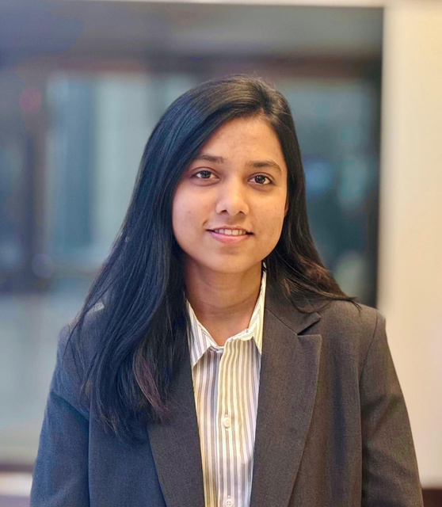



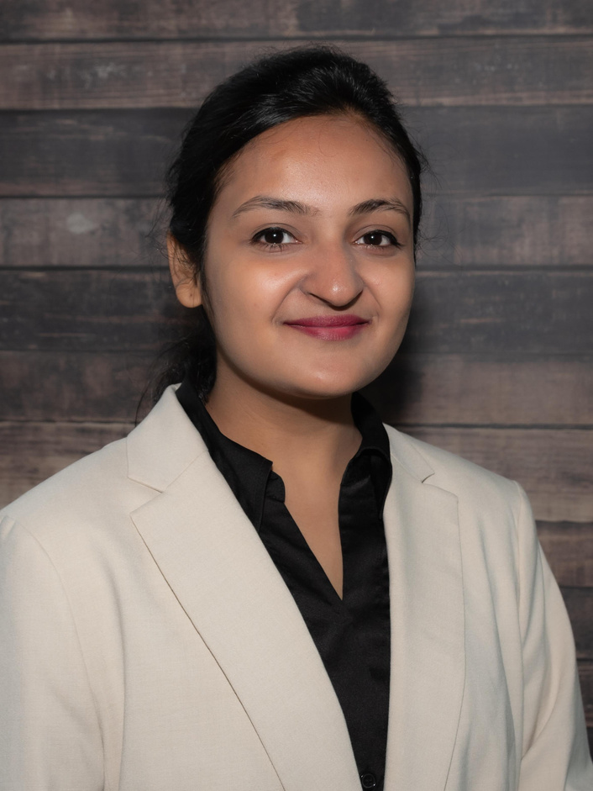

PROFESSIONAL TEAM
Tanjina Moon
Kavita Adha
Osigbemhe Ikhanoba
Model Developer & Data Analyst
Market Research & Insights Analyst
App Developer & Data Analyst
Rufus Stewart
Chad Gibbons
Surveyors
Architect
Omkar Sheth
Mishika Bhandari
Omkarsinh Rana
02
Research
Research
Research

Slide 3
01
02
Our Project Workflow
Market Overview
Data Exploration
“USC’s position in local construction market”
“Looking at workforce, attendance, and attrition data”
We wanted to help USC understand why employees leave and how to keep them longer.
03
04
Modeling & Insights
Strategic Recommendations
“Identifying what factors drive people to leave or stay”
“Five concrete workforce strategies based on the data”
03

Slide 4
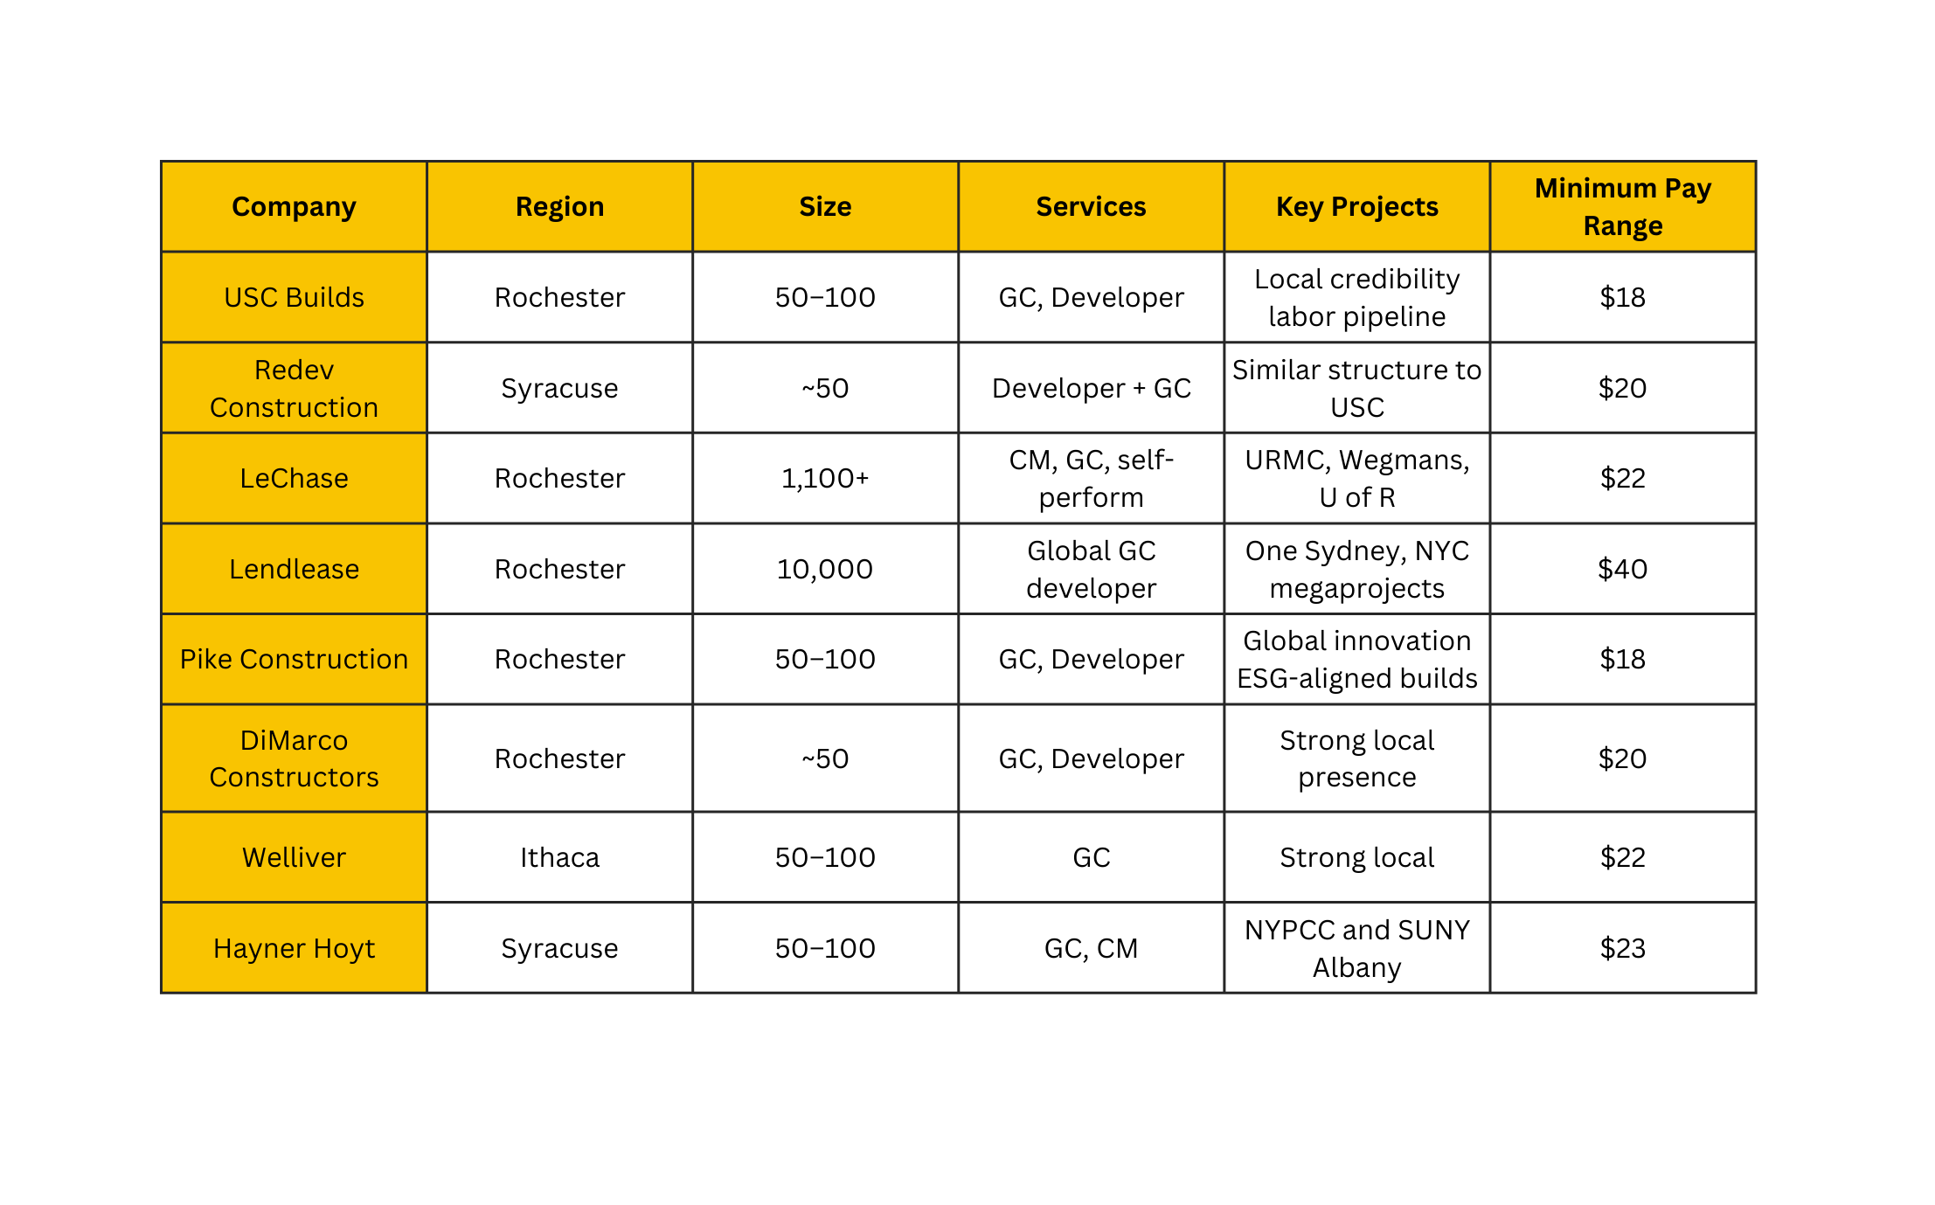
04

Slide 5
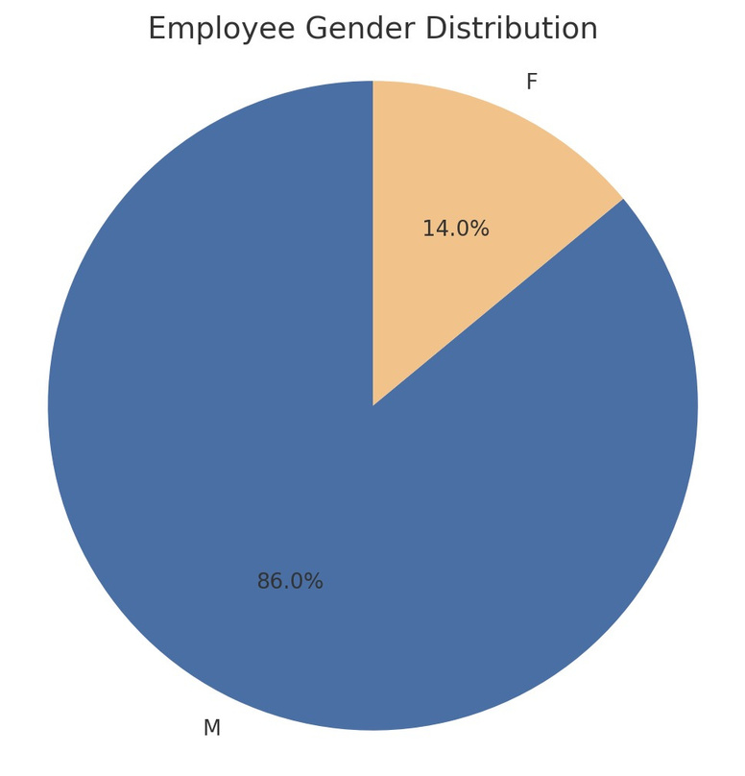
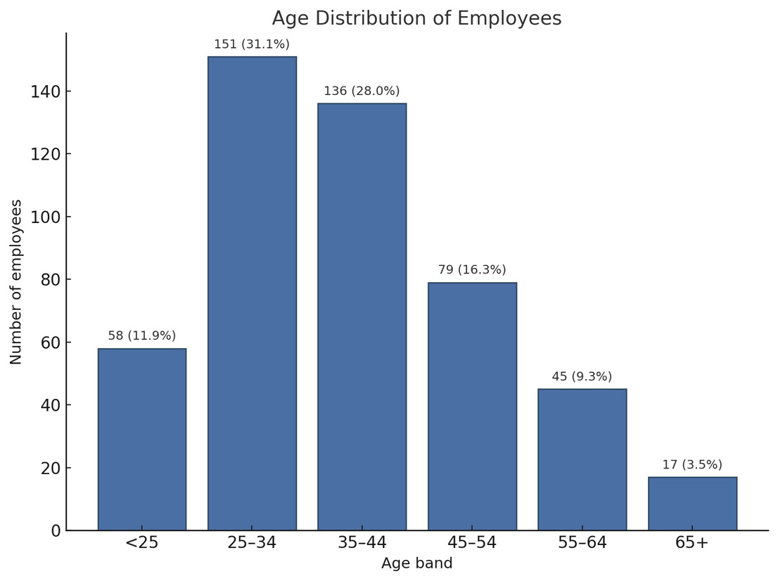
86% of employees are male; only 14% are female.
59% of staff are between ages 25-44.
Only 12% are under 25 and 13% are aged 55 or older.
Most Employees Are Male and Aged 25-44, but Few Are Under 25
05

Slide 6
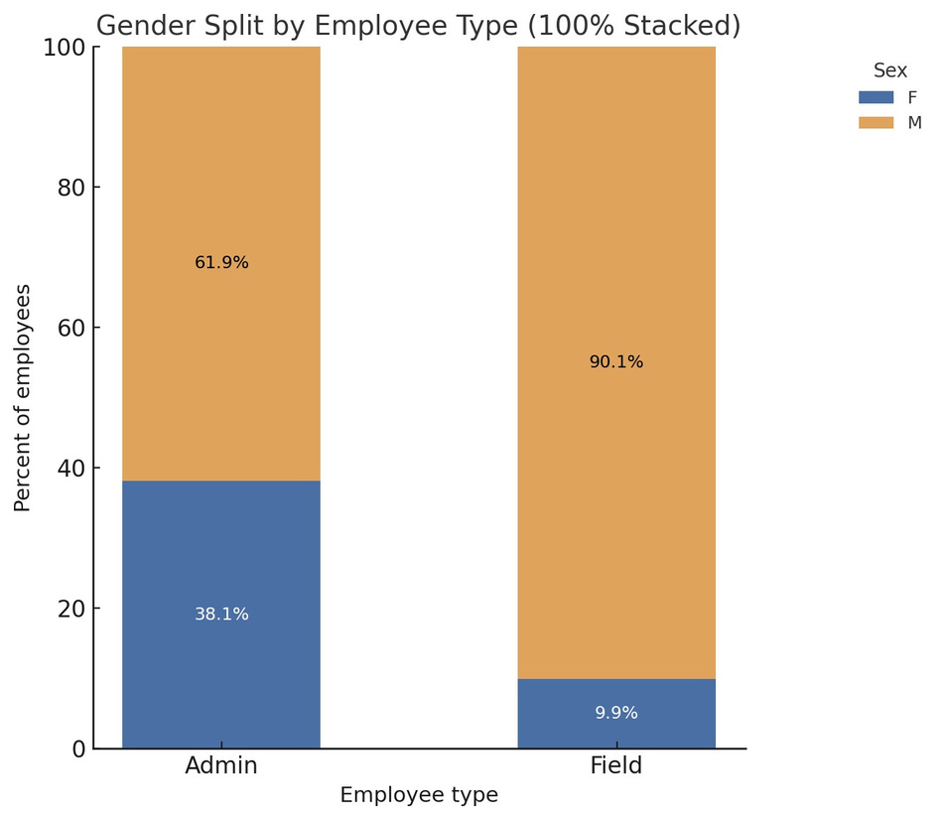
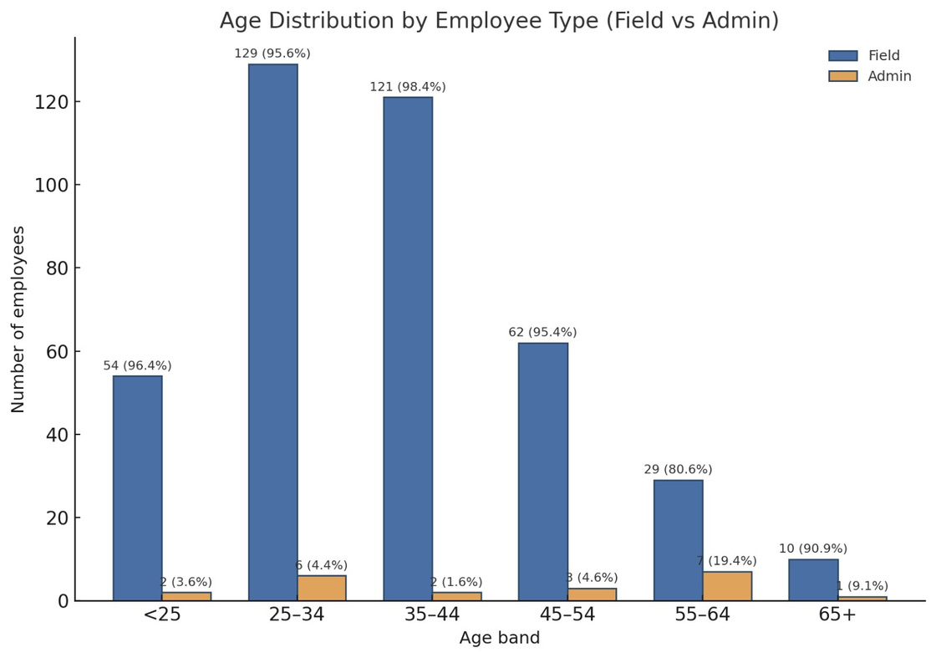
90% of field workers are male; admin roles have 38% female staff
Over 95% of employees under 45 work in field roles
Female and admin employees are more common in older age bands
Admin staff are more gender-balanced, while field staff are mostly young men
06

Slide 7
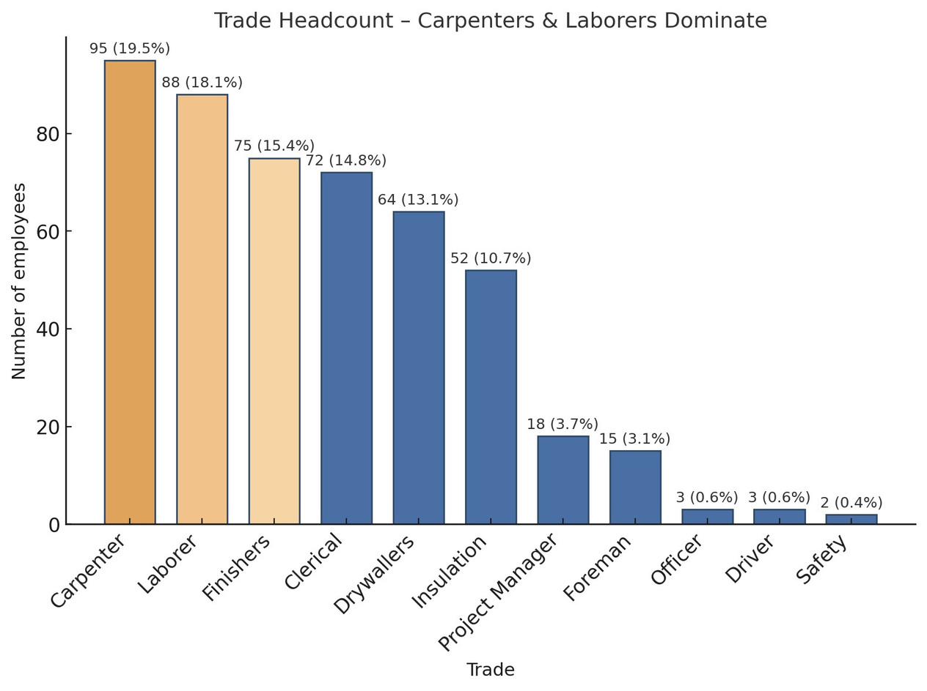
Over Half of Employees Are Carpenters, Laborers, or Finishers
Carpenters (19.5%) and laborers (18.1%) form the largest groups
Together with finishers (15.4%), they make up over 53% of the workforce
Safety, officer, and driver roles are less than 1% each
07

Slide 8
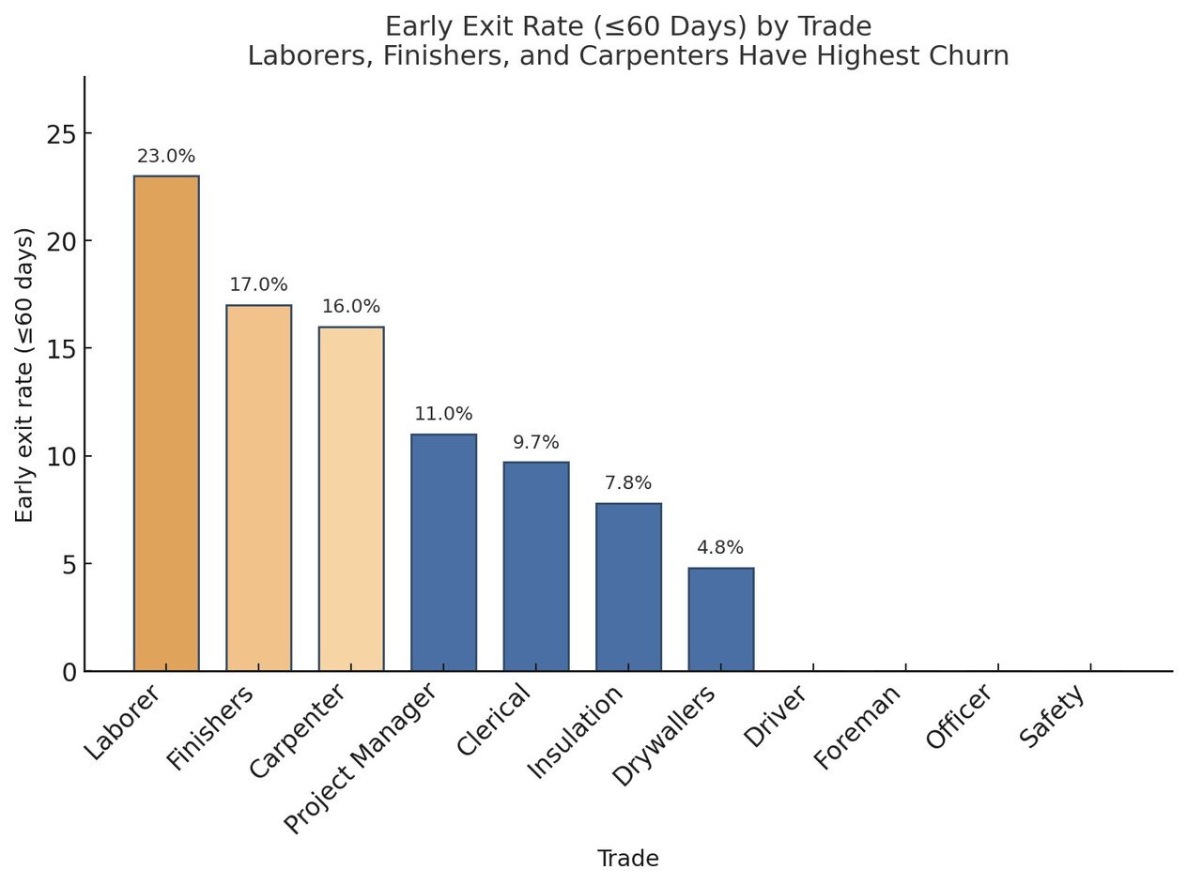
Laborers and Finishers Have the Highest Early Exit Rates
23% of laborers leave within 60 days
Finishers and carpenters also show high churn at 17% and 16%
Officer, safety, and foreman roles had zero early exits
08

Slide 9
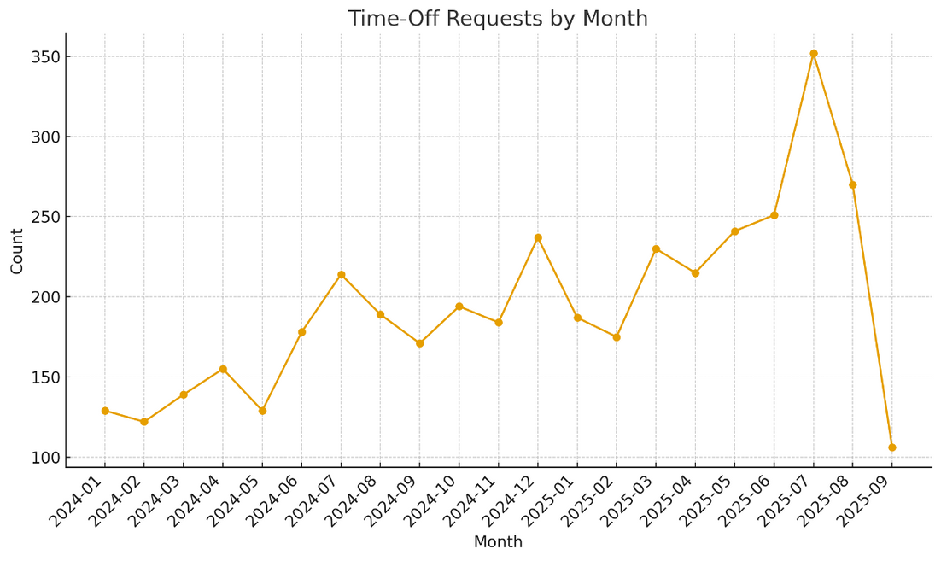
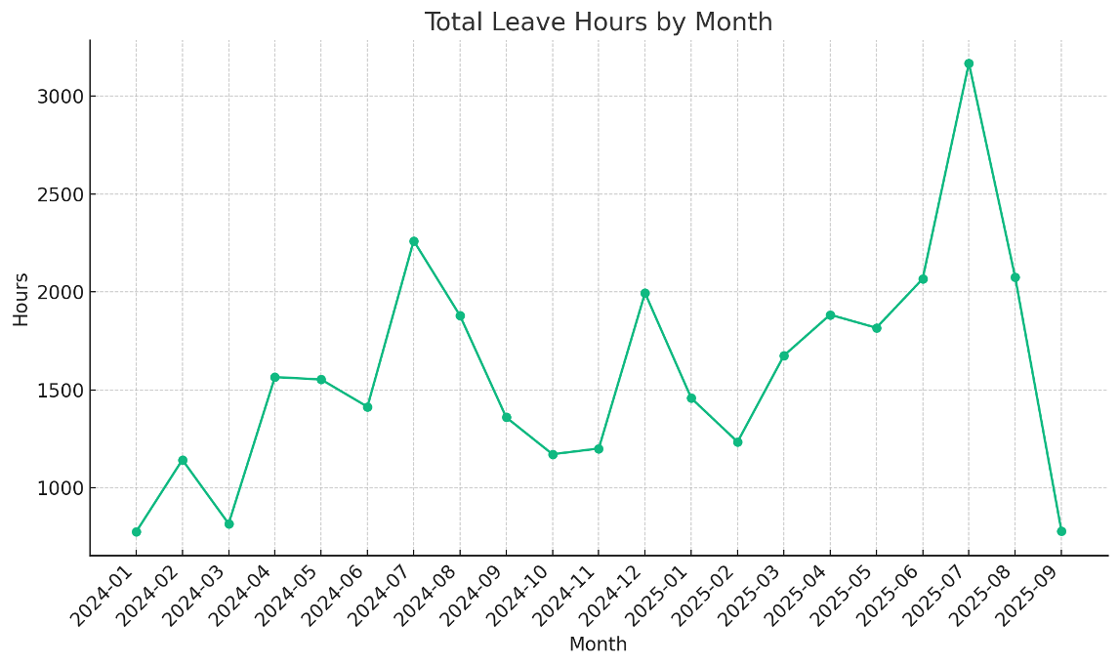
Sharp spikes in July, August, and December show the highest time-off activity
July 2025 saw over 350 time-off requests and 3,200 leave hours
Time-Off Peaks in Summer and December
08
09

Slide 10
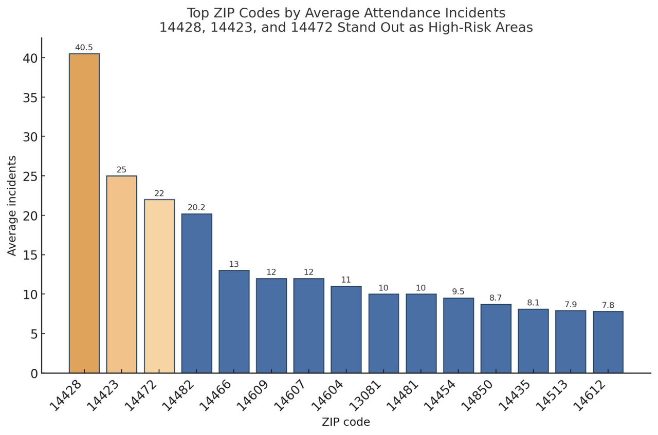
Areas Like Churchville and Caledonia Have the Most Attendance Incidents
Churchville (14428) has the highest average with 40.5 incidents
Caledonia (14423) and Honeoye Falls (14472) also show high incident rates
Other areas like Geneseo and Brockport show lower but notable averages
10

Slide 11
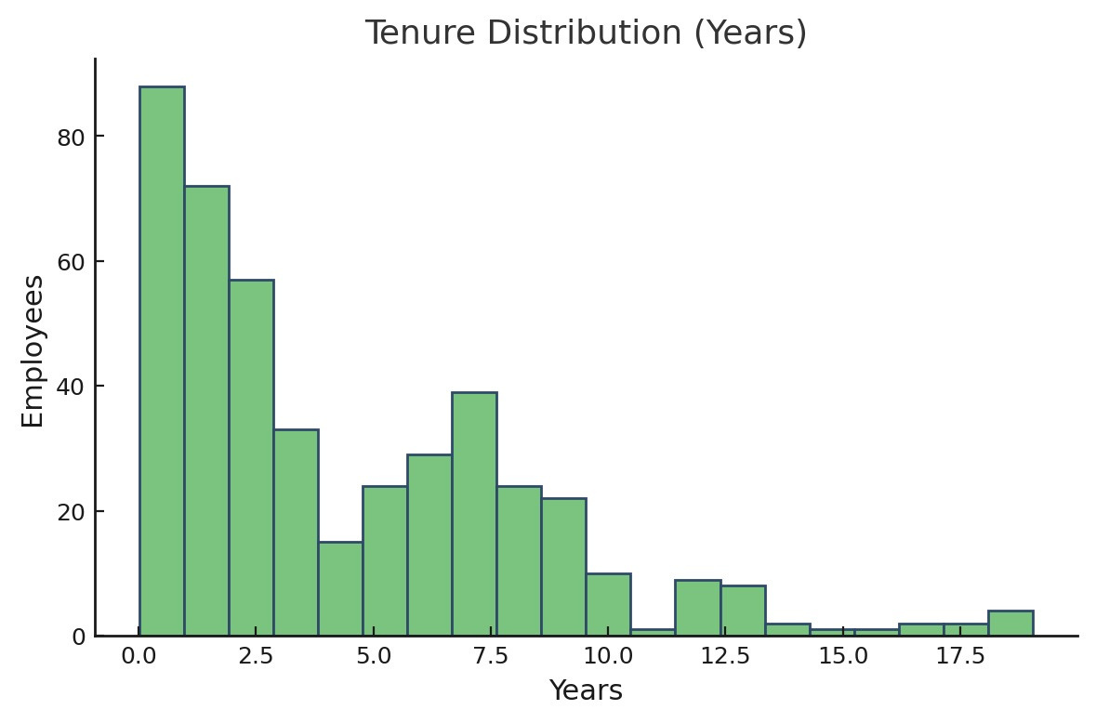
Most Employees Have Less Than 3 Years of Tenure
Over 60% of employees have under 3 years of service
Tenure sharply declines after 3 years
Very few employees stay beyond 10 years
11

Slide 12
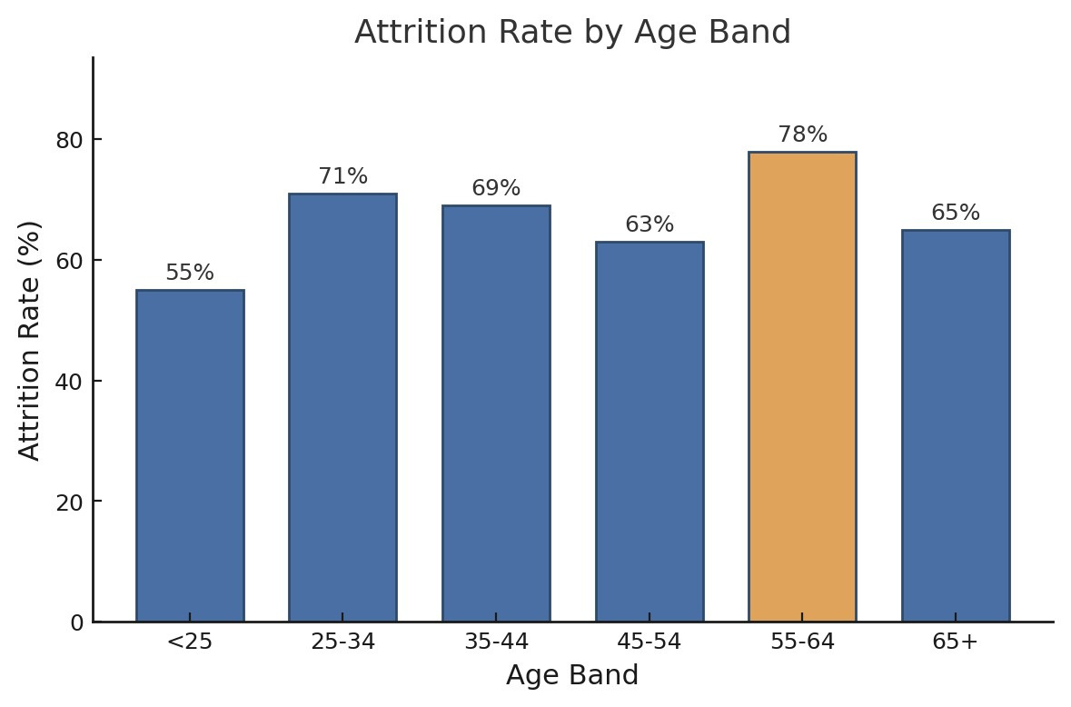
Attrition Is Highest Among Ages 55–64
78% attrition rate for employees aged 55–64
25–44 age group also faces high attrition (~70%)
Younger workers (<25) have the lowest attrition at 55%
12

Slide 13
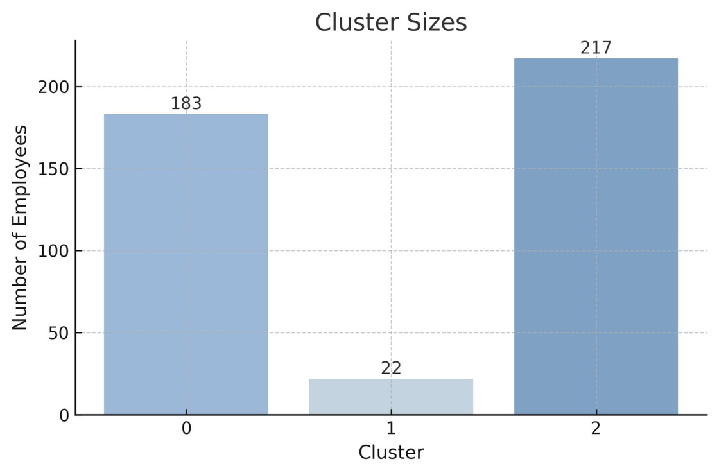
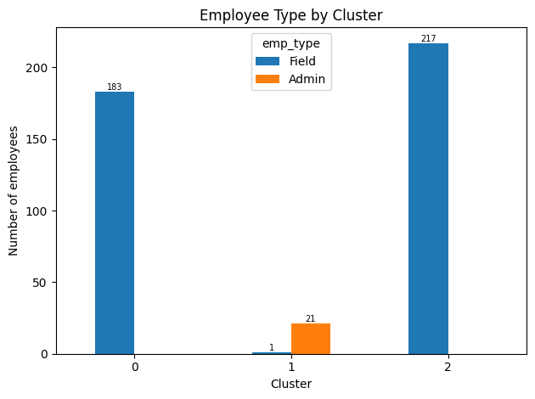
Cluster Breakdown: Risky Newcomers, Steady Admins, and Committed Field Staff
Cluster 0 – Risky Newcomers: 183 employees, all field
Cluster 1 – Steady Admins: 22 employees, all admin
Cluster 2 – Committed Field Staff: 217 employees, all field
08
13

Slide 14
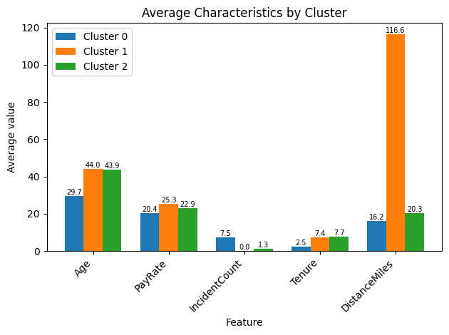
Clear Differences in Cluster Behaviors
Risky Newcomers (Cluster 0): Youngest, lowest pay & tenure, highest incidents
Steady Admins (Cluster 1): Oldest, highest pay, longest commutes, no incidents
Committed Field Staff (Cluster 2): Longest tenure, few incidents, moderate pay
14

Slide 15
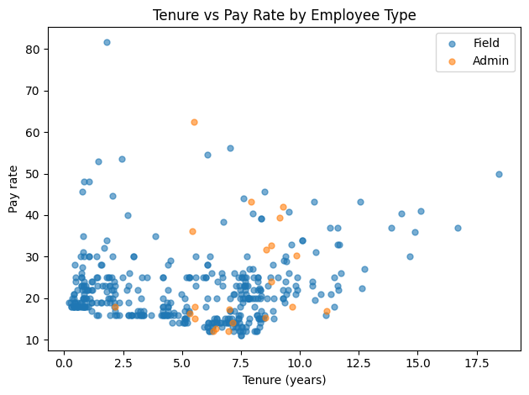
Pay Rate Varies Widely Regardless of Tenure
Most employees earn between $15–30/hour
Longer tenure doesn't always mean higher pay
A few Admins earn above $50/hour despite shorter tenure
15

Slide 16
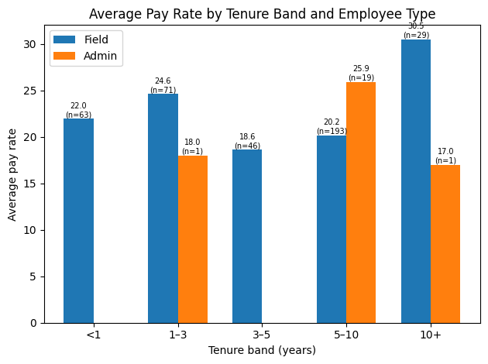
Field Staff Earn More with Longer Tenure
Field pay peaks at $30.5/hour for 10+ years
Highest Admin average is $25.9/hour at 5–10 years
16

Slide 17
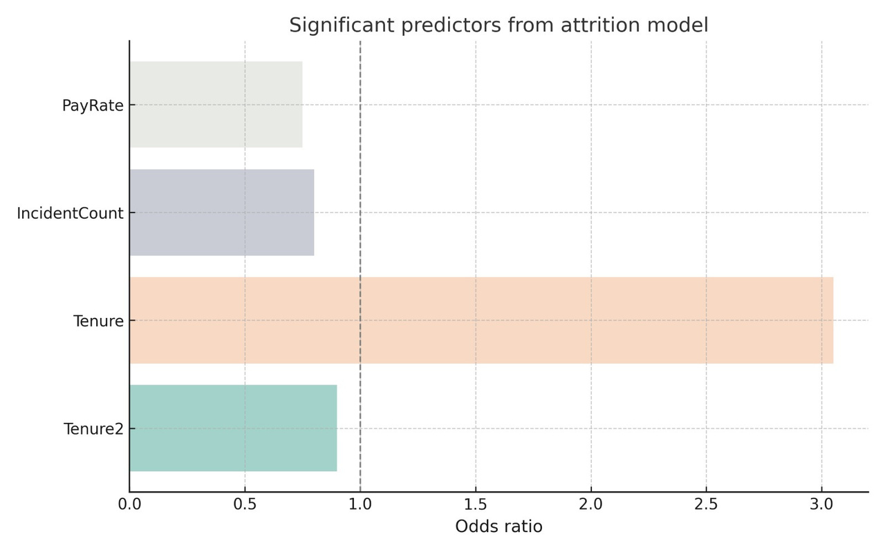
Tenure Strongly Predicts Attrition
Longer tenure increases attrition risk (odds ratio > 3)
Incident count and low pay also raise risk
Tenure² term suggests non-linear effects
17

Slide 18
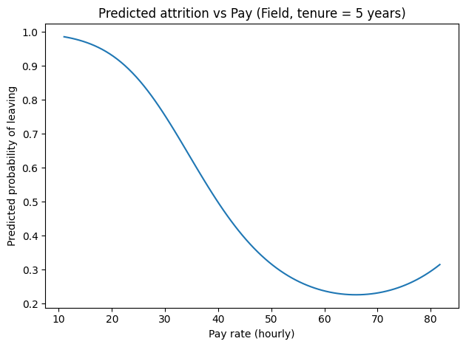
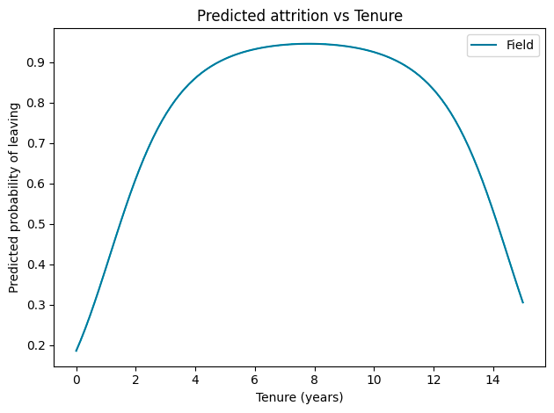
Low pay (<$20/hr) shows very high attrition risk (~95%), which falls sharply as pay increases.
Mid-tenure (4–10 years) employees have the highest probability of leaving (~90%).
Attrition Drops Strongly with Higher Pay and Very Long Tenure
18

Slide 19



RECOMMENDATIONS
Unlock growth by fixing five specific workforce problems
Vision
Mission
Five workforce problems blocking growth:
New field workers leaving in the first ninety days
High attendance issues in distant zip codes (14622, 14626)
Mid-career employees leaving between three and seven years
Older experts (age fifty five to sixty four) leaving without successors
Very high attrition in the lowest pay band
A five-part, data-driven plan:
Stop early exits in the first ninety days
Fix attendance in 14622 and 14626 using the site–worker app
Retain mid-career employees with clear “next-role” paths
Keep older experts and transfer their knowledge
Raise the pay floor to reduce low-pay attrition
19

Slide 20

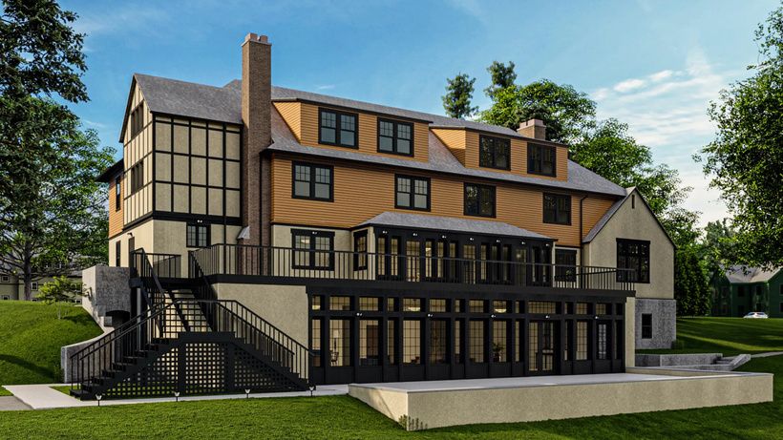
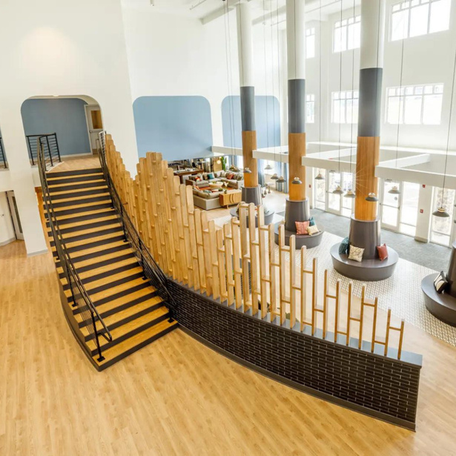

RECOMMENDATIONS
First ninety days programme
Work near home for 14622 and 14626
Pay floor and simple pay bands
Do: Show five-year path in the app, assign a buddy, and complete three check-ins before day ninety.
Result: Fewer new workers leaving in the first ninety days.
Do: Use the app to place these workers at the nearest sites and support carpool or pick-up from one hub.
Result: Lower attendance incidents from distant zip codes.
Do: Set a minimum pay above the highest-risk level and group all roles into clear pay bands.
Result: Reduced attrition among the lowest paid workers.
21

Slide 21
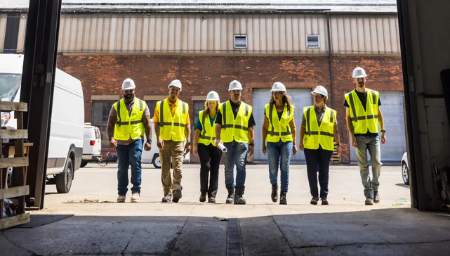

RECOMMENDATIONS
“Next-role” paths for mid-career employees
Senior expert and knowledge transfer roles
Do: For every employee with 3-7 years tenure, define the next role, timeline, skills, and pay step.
Result: More employees stay beyond 5 years and move into leadership roles.
Do: Create a lighter “Senior Professional” role and pair each senior with juniors for planned skill transfer.
Result: Experience is retained and juniors are ready to replace departing experts.
21

Slide 22

GET IN TOUCH WITH USC APP
Workforce Insights App gives each worker a live view of their performance, skill progress, career path, and nearby USC Builds job sites in one place.
Key Features
Peer review system for performance feedback
“Find jobs near me” location-based job matching
Seamless data pipeline combining attendance, tenure, and HR data
Personalized career progress tracker
Early-exit risk detection
Milestone roadmap (6-month skills training → promotion path)
22

Slide 23
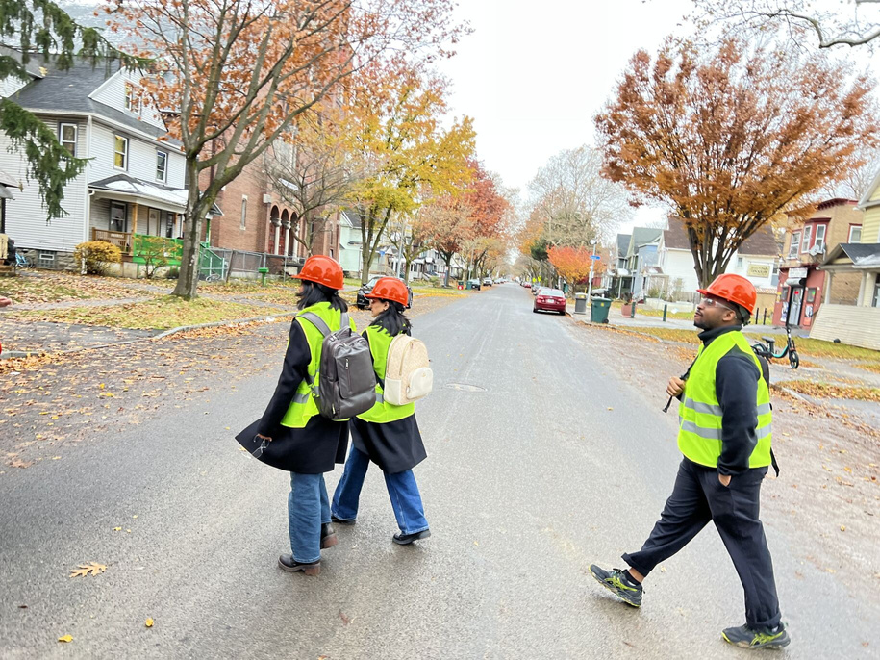

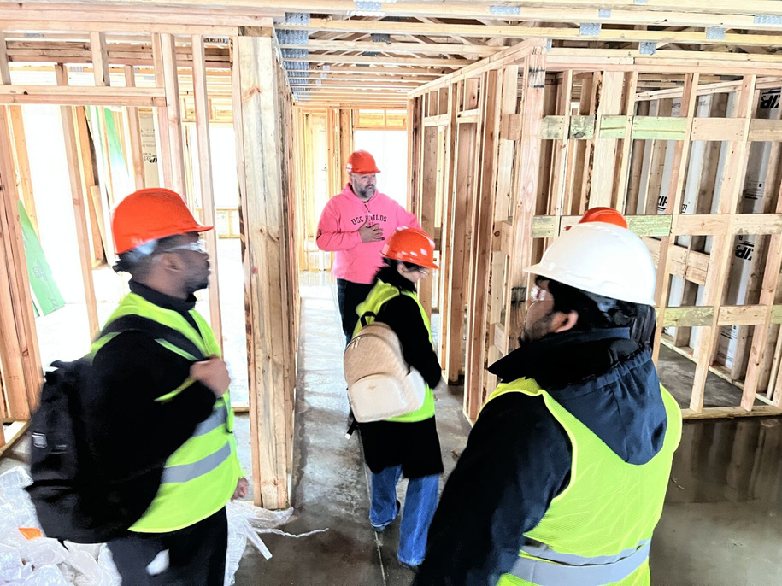
THANK YOU!!!
Thank you for inviting us for site visit and have a closer look at USC Builds work and process, it gave us clear insights about company.
It was a wonderful Experience.
23

Slide 24

THANK
YOU
For Your Attention

Slide 25
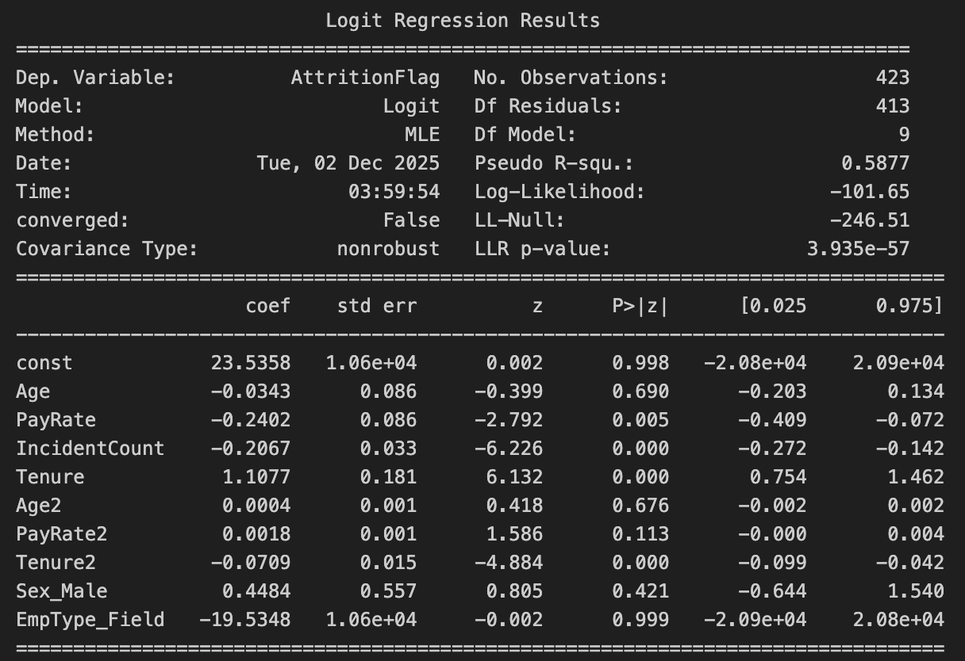
Appendix
Predictive Model
Your jbbparagraph text

Slide 26
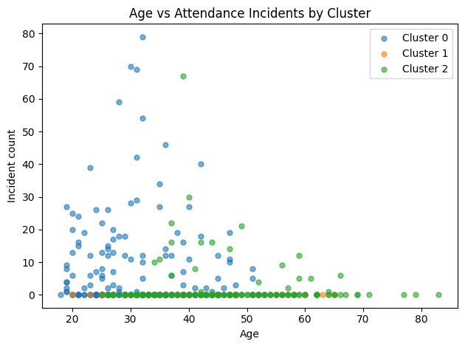
Appendix
Clustering
Your jbbparagraph text

Slide 27
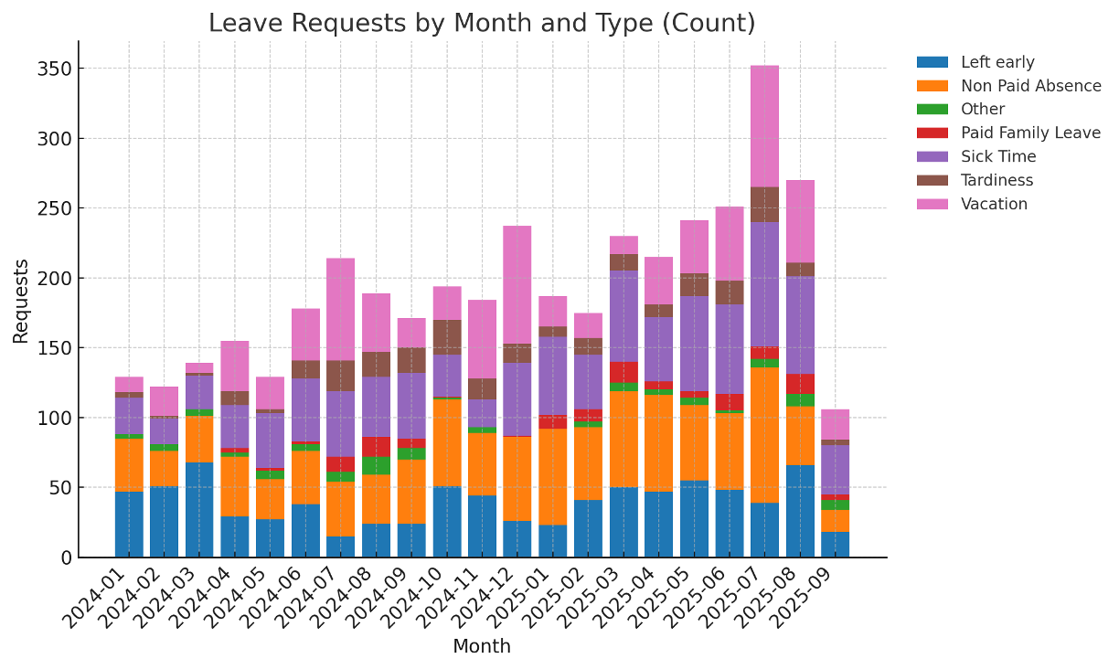
Appendix
Detailed Admin Outliers
Elijah Hicks (Employee 191)
Age 34
Tenure: ~11.1 years
Pay: $17/hr
96 distinct projects
Shawn Adams (Employee 658)
Age 20
Tenure: ~2.1 years
Pay: $18/hr
Only 3 projects so far
Types of leave request by month
Your jbbparagraph text

